Slide 1
Classification Of Plants Diseases Using Computer vision
Team Names:
Doha Metwally Salah
Bassant Said

Slide 2
agenda
Objective
Dataset
EDA
Model 1
Model 2
VGG16
ResNet50
Conclusion

Slide 3

Objective
To detect healthy and unhealthy regions of plants leave
Classification of plants leaf disease using texture feature
To analyze leaf infection
​

Slide 4
Dataset
we are downloading the dataset from Kaggle
https://www.kaggle.com/datasets/vipoooool/new-plant-diseases-dataset
This dataset consists of about 87K rgb images of healthy and diseased crop leaves
which is categorized into 38 different classes.
The total dataset is divided into 80/20 ratio of training and validation set preserving the directory structure.
A new directory containing 33 test images is created later for prediction purpose.

Slide 5
EDA

Slide 6
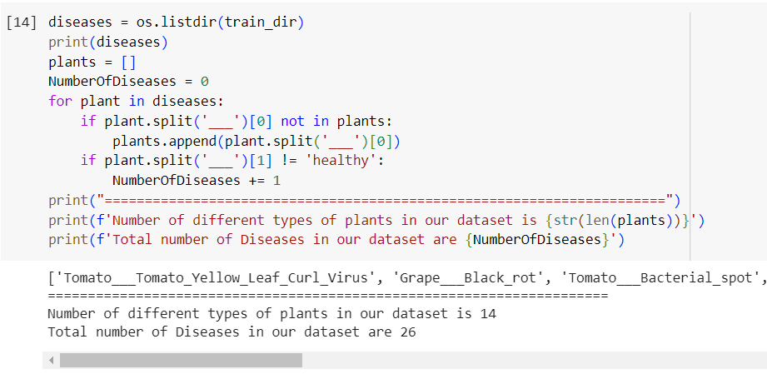

Slide 7
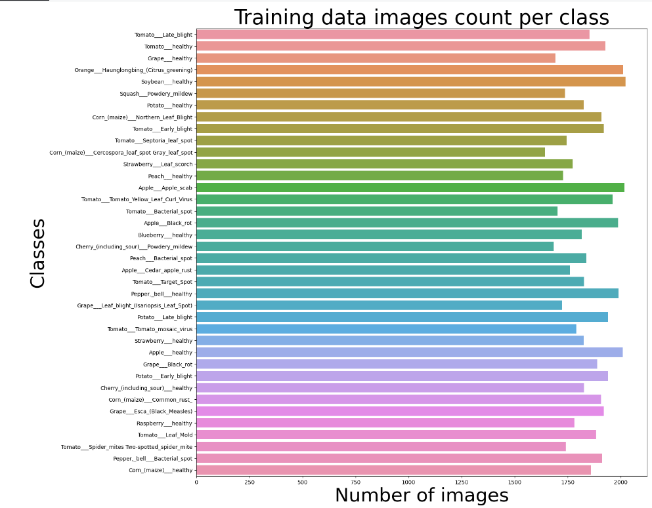
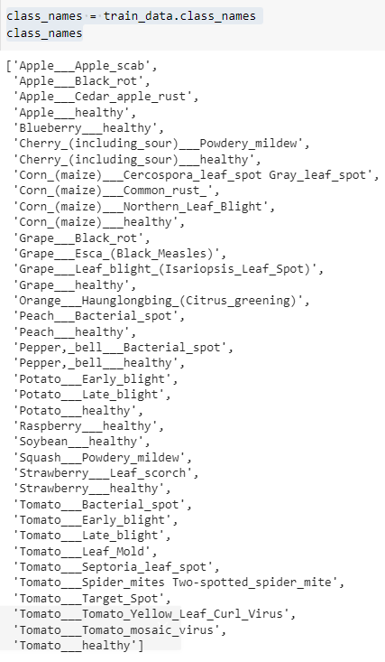

Slide 8
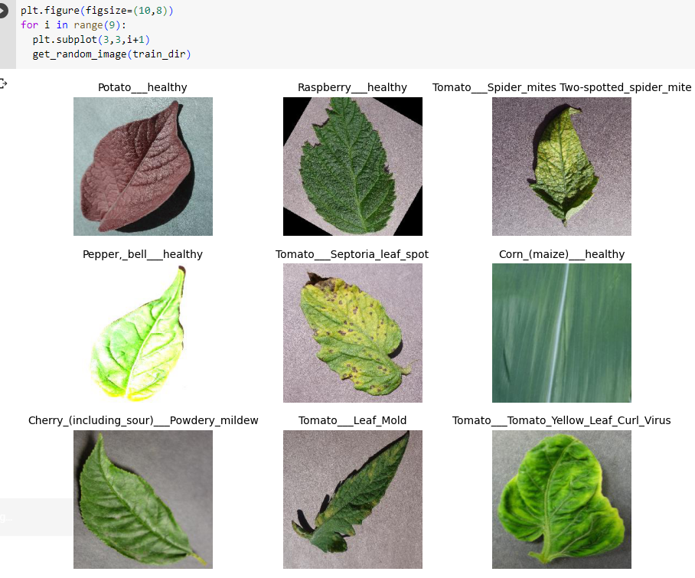

Slide 9
we used different models Pretrained
and non pretrained models

Slide 10
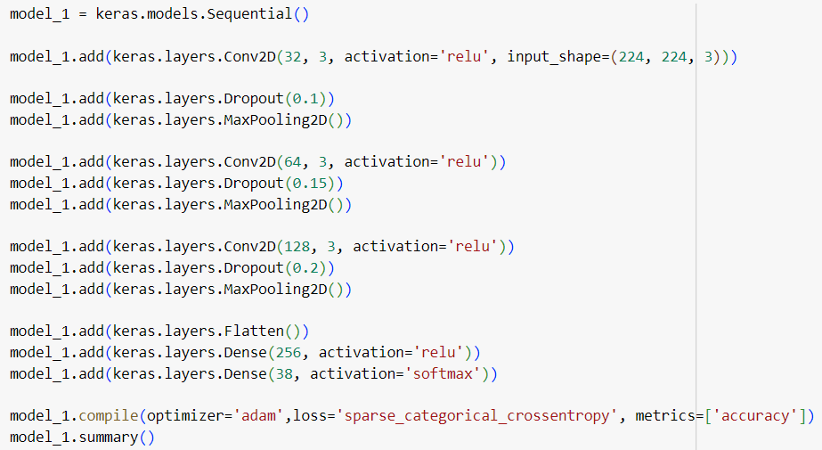
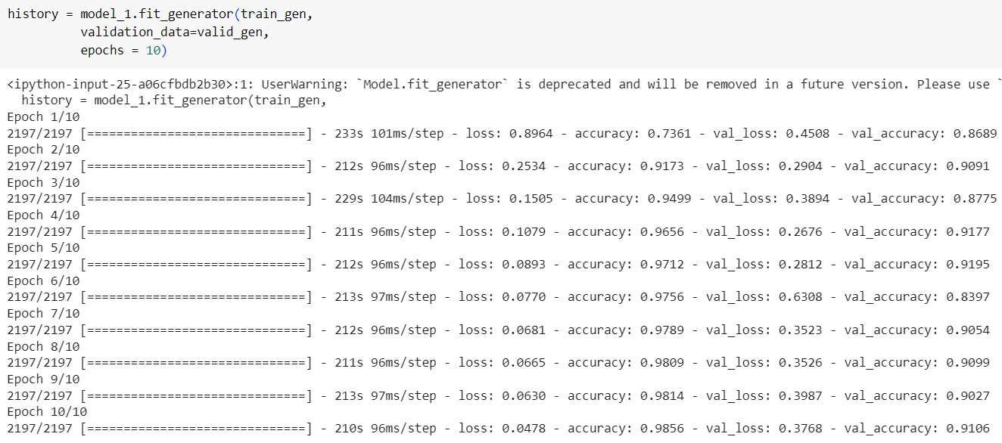
Model 1

Slide 11
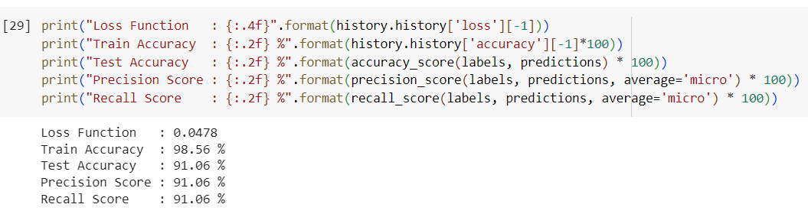
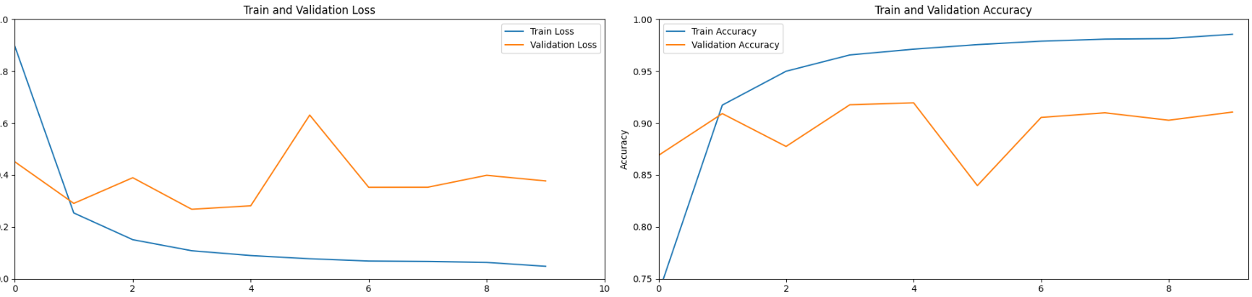

Slide 12
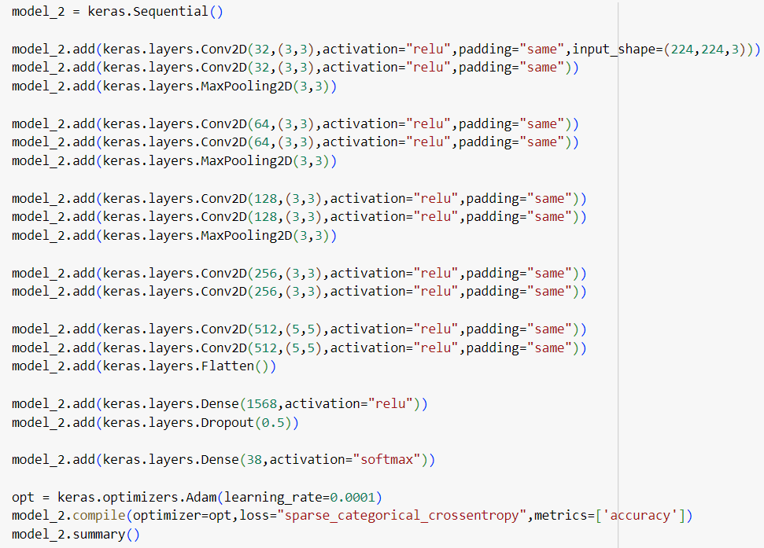
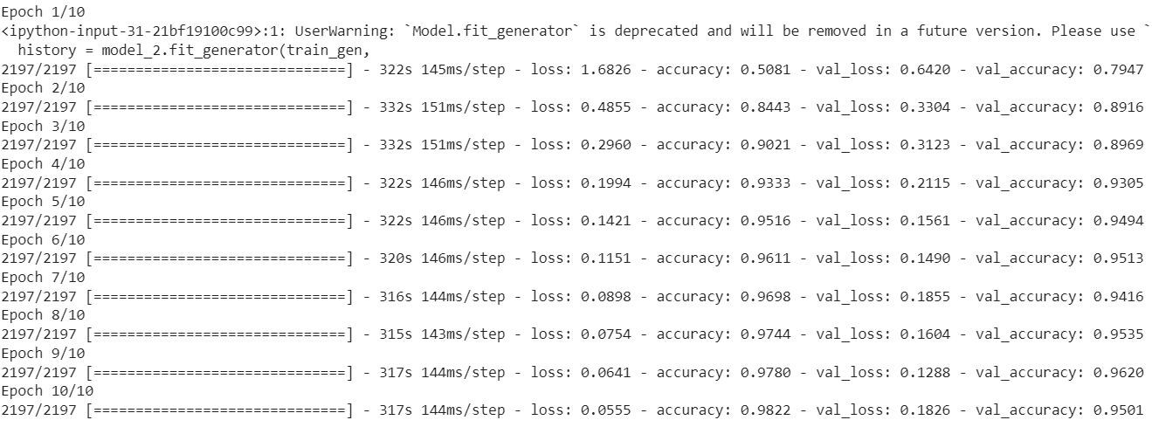
Model 2

Slide 13
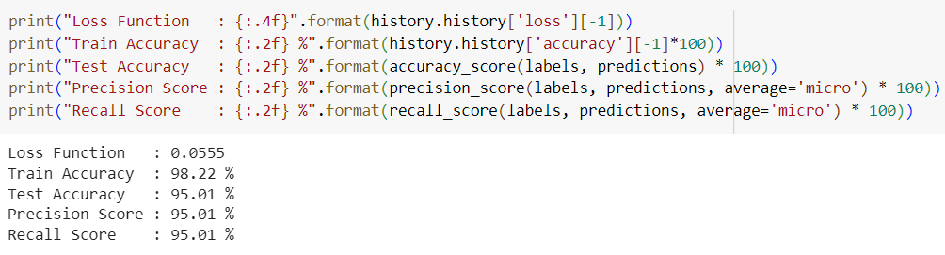
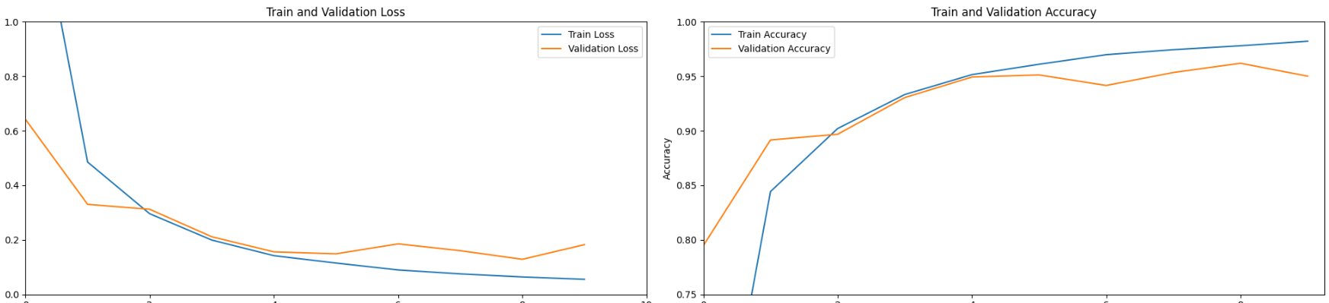

Slide 14
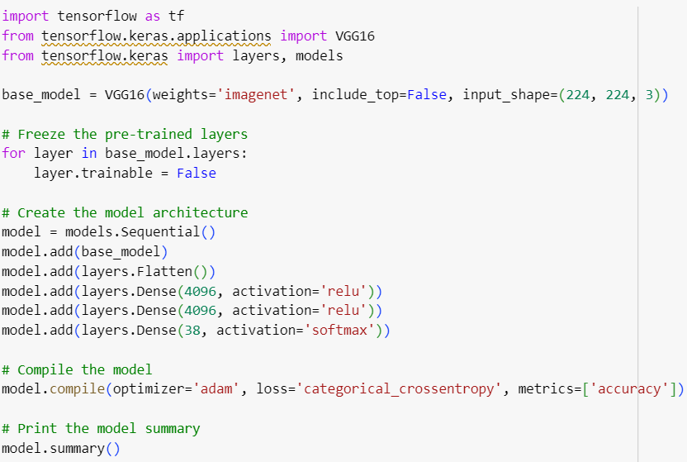
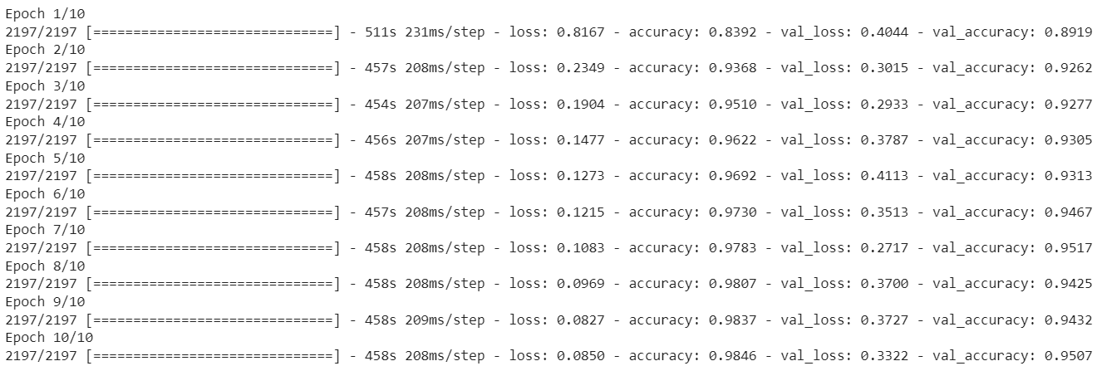
VGG16

Slide 15
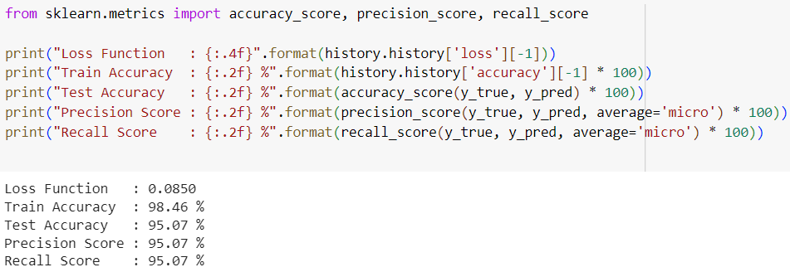
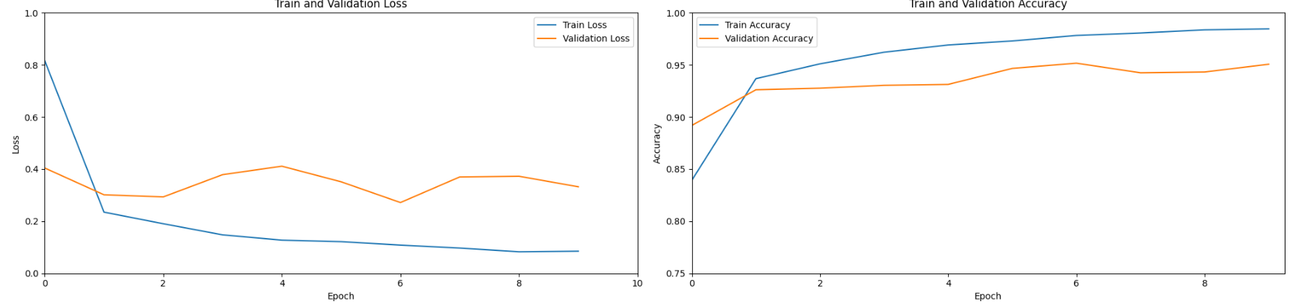

Slide 16
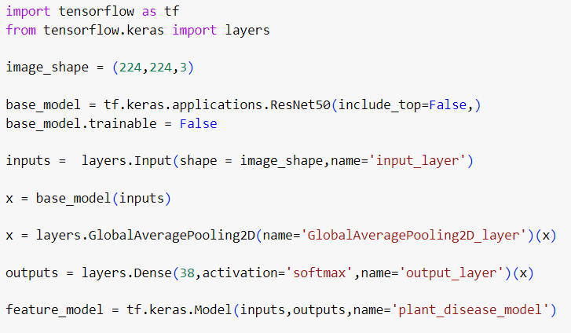
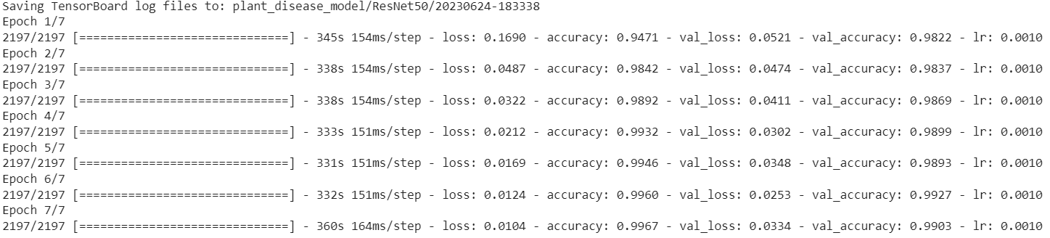
ResNet50

Slide 17
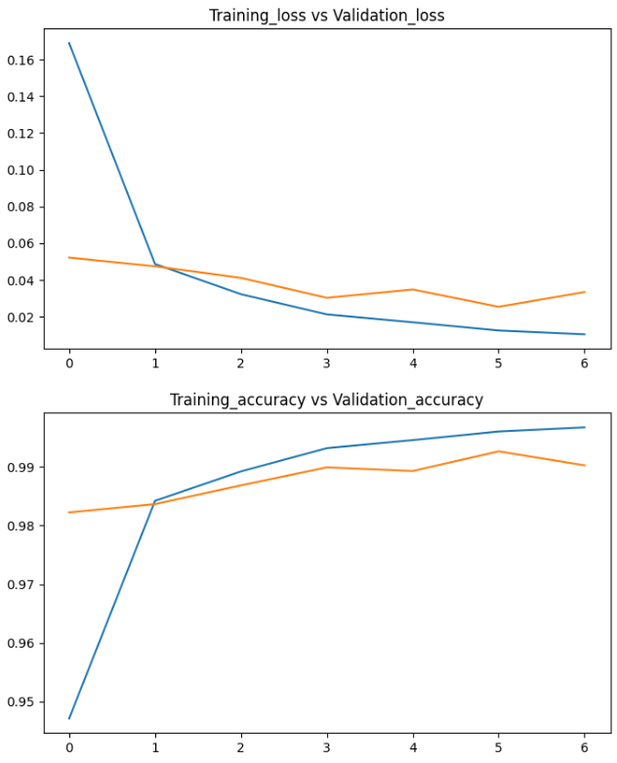
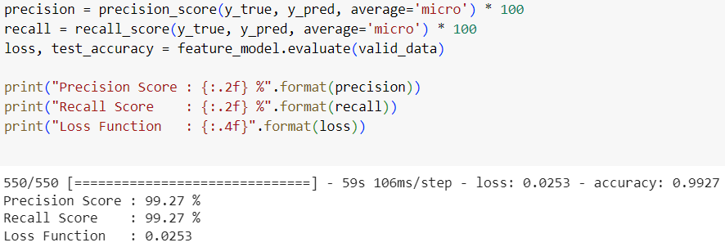

Slide 18
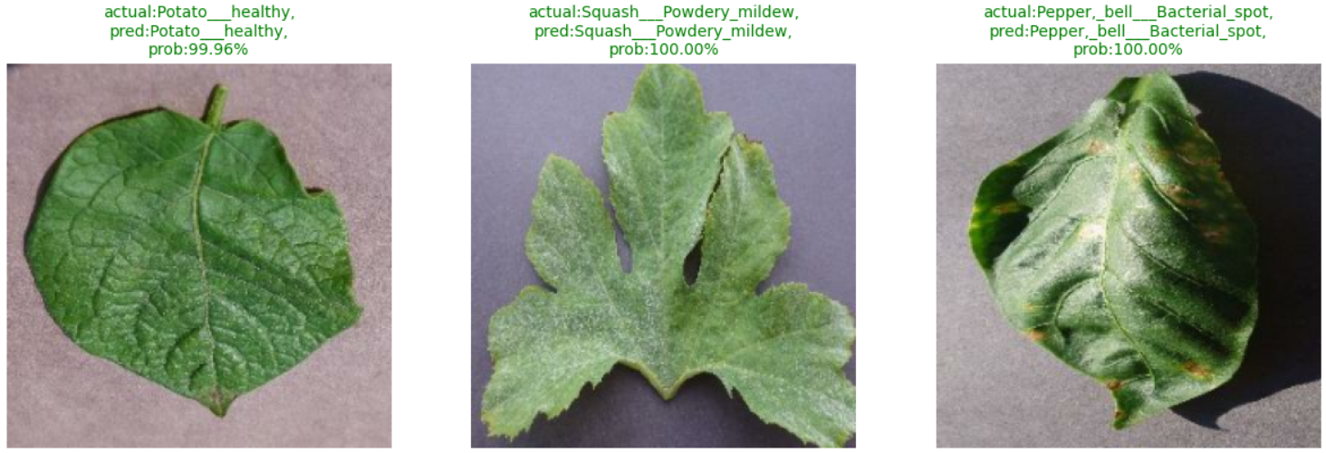

Slide 19
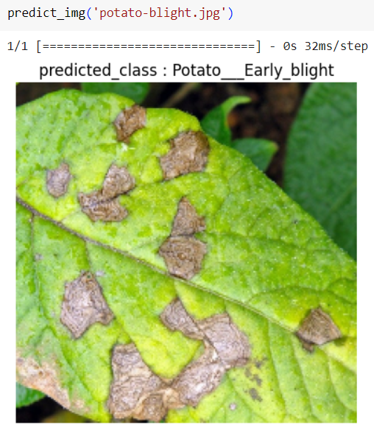
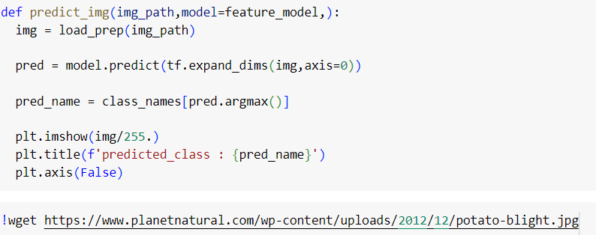
Test Image From Google

Slide 20
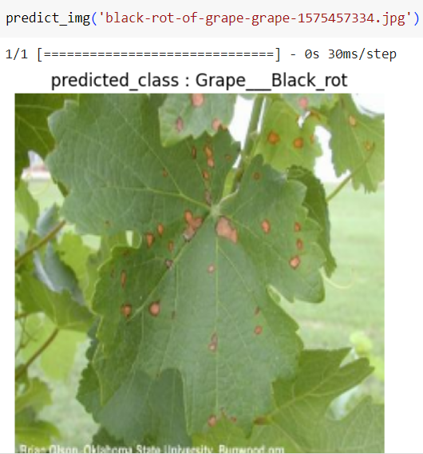
Test Image From Google

Slide 21
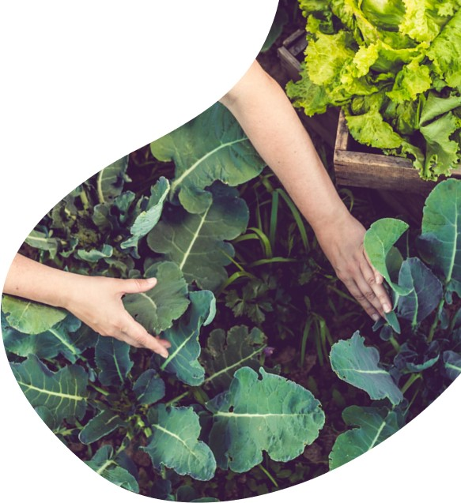
conclusion
This project demonstrates the potential of computer vision techniques and deep learning models for plant disease classification. By leveraging pre-trained models and transfer learning, we were able to build a robust model with high accuracy. Such models can be valuable tools for farmers and plant experts to quickly and accurately diagnose plant diseases, leading to timely interventions and improved crop health.

Slide 22
thank you

